Slide 1


Computational Intelligence (TC2027)

Slide 2
Unit 5 – System Security (III)
Exploit Permissions Lab

Slide 3

SU
Allows commands to be run with a substitute user and group ID.
$ su barreto
SU is very useful to a normal user became the root (Linux admin).
$ su -
The su command can be used by any user for a very simple fact, you need to know the root password to log in.

Slide 4
SUDO
Allows commands to be run with a substitute user and group ID.
$ sudo su
You do not need to know the password for the “root” user to use “sudo”, only for your user;
The "sudo" command does not log in with the "root" user, it just performs the requested task as "root" and goes back to your shell;
This command is controlled by the “sudoers” file, which, among thousands of other things, indicates which users can perform which tasks in the system.

Slide 5
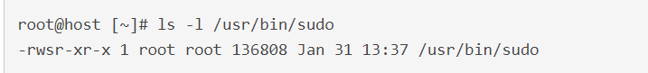
Setuid()
Setuid is a Linux file permission setting that allows a user to execute that file or program with the permission of the owner of that file.
This is primarily used to elevate the privileges of the current user.
The most common example of this in Linux is ‘sudo’.

Slide 6
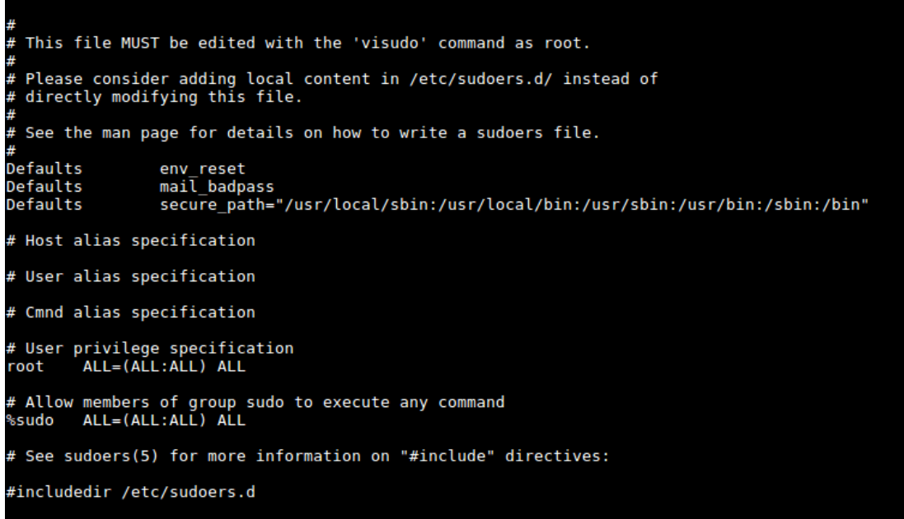
SUDO CONFIGURATION
ALL = - indicates the host, in this case we are indicating “all hosts”;
(ALL: ALL) - indicates that the “root” user can execute commands like all users and groups respectively.
ALL - applies to any command that the user is trying to execute with "sudo".
/etc/sudoers or visudo

Slide 7
SUDO CONFIGURATION
% sudo - indicates the name of the group that we will configure to gain access to sudo, in this case the group "sudo";
ALL = - indicates the host, in this case we are indicating “all hosts”;
(ALL: ALL) - indicates that the “root” group can execute commands like all users and groups respectively.
ALL - applies to any command that the group is trying to execute with "sudo".
/etc/sudoers or visudo

Slide 8
ADDING A NEW USER
luizotavio ALL=(ALL:ALL) ALL
Similar root line
luizotavio ALL=(ALL:ALL) /usr/bin/apt-get, NOPASSWD:/sbin/ifconfig
In this case you specify the commands.

Slide 9
Why does the Permission Elevation Attack work?
Now, you know which command the user can run, using the sudo command. You see that your default user (mx) can perform any command using sudo. You can use for example the find command’s exec parameter for arbitrary code execution.
$sudo find /home -exec sh -I \;

Slide 10
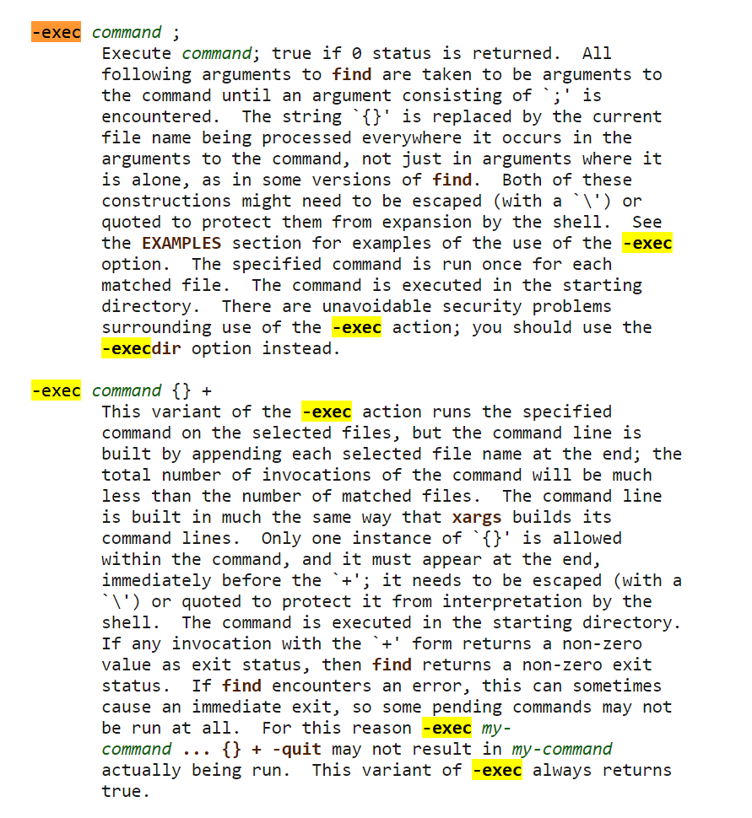
Why does the Permission Elevation Attack work?

Slide 11

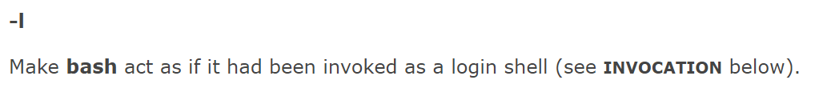
Why does the Permission Elevation Attack work?

Slide 12



But I need to have a user account to perform this attack. How can I do it?
Social Engineering
Sniffing

Slide 13
Next Step
Now, we want to crack the password file to obtain another user and the system's passwords.
A couple of files of particular interest on Linux systems are the /etc/passwd and /etc/shadow files.
The /etc/passwd file contains basic information about each user account on the system, including the root user which has full administrative rights, system service accounts, and actual users.
The /etc/shadow file contains the encrypted passwords of users on the system.
While the /etc/passwd file is typically world-readable, the /etc/shadow is only readable by the root account

Slide 14
John the Ripper
John The Ripper is an open source and very efficient password cracker by Open-Wall.
It was originally built for Unix but is now available for fifteen different platforms including Windows, DOS, BeOS, OpenVMS and Unix like operating systems.
Required software's:
John
snapd

Slide 15


John the Ripper (Modes)
Single Crack: Fastest mode if a full password file is available
Wordlist: Attempts passwords found in word lists, works very well against simple passwords
Incremental: True brute-force, tries every possible combination until a match is found (or not)

Slide 16
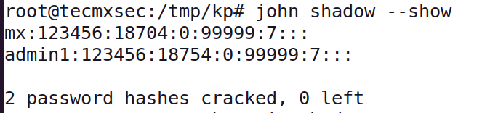
/etc/shadow
Output of John the Ripper

Slide 17
Unit 5 – System Security (III)
Exploit Permissions Lab

Slide 18
Computational Intelligence (TC2027)

